Slide 1

ARTIFICIAL INTELLIGENCE
&
MACHINE LEARNING
SESSION NO : 31

Slide 2
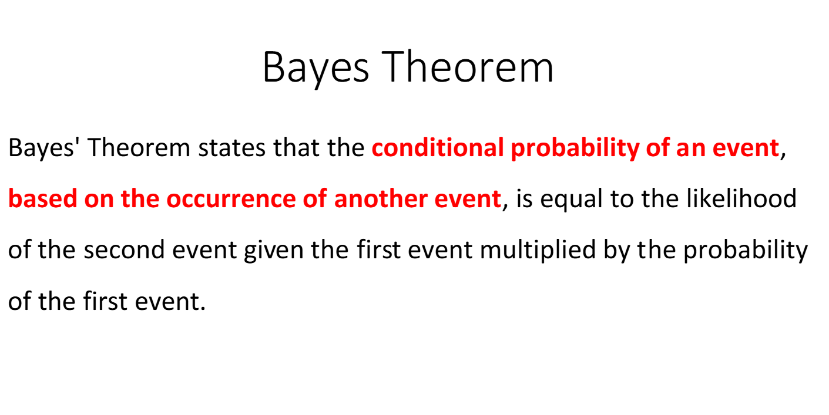

Slide 3
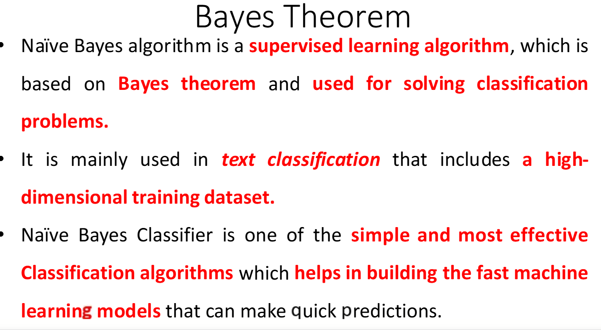

Slide 4
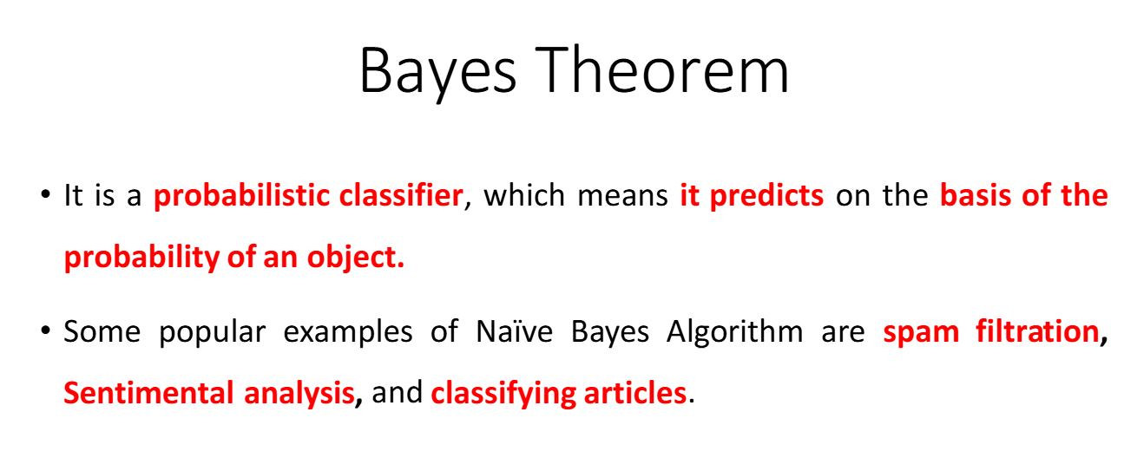

Slide 5
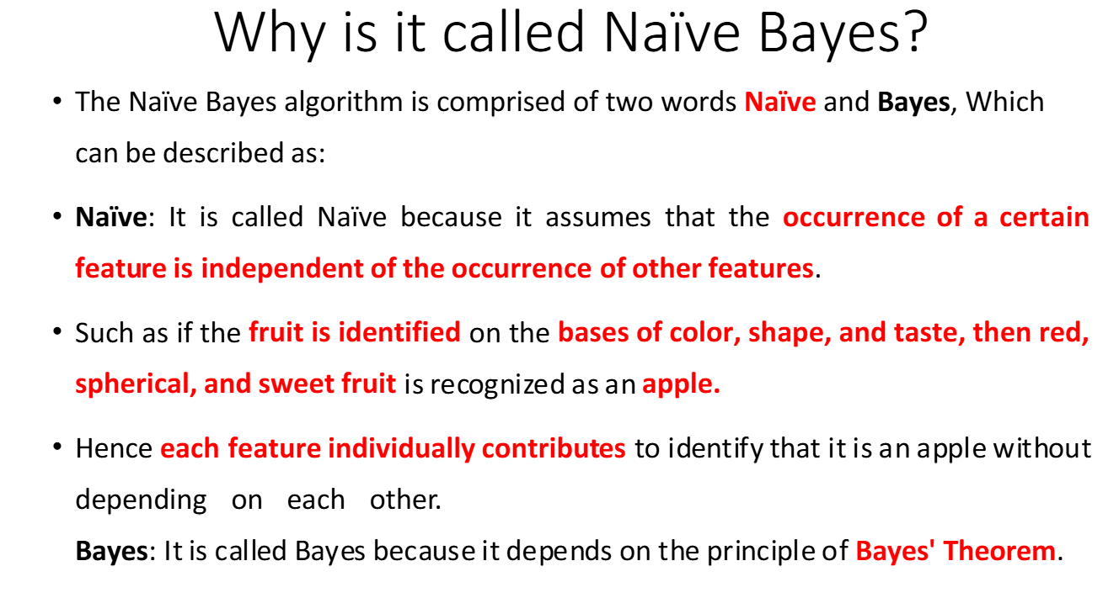

Slide 6
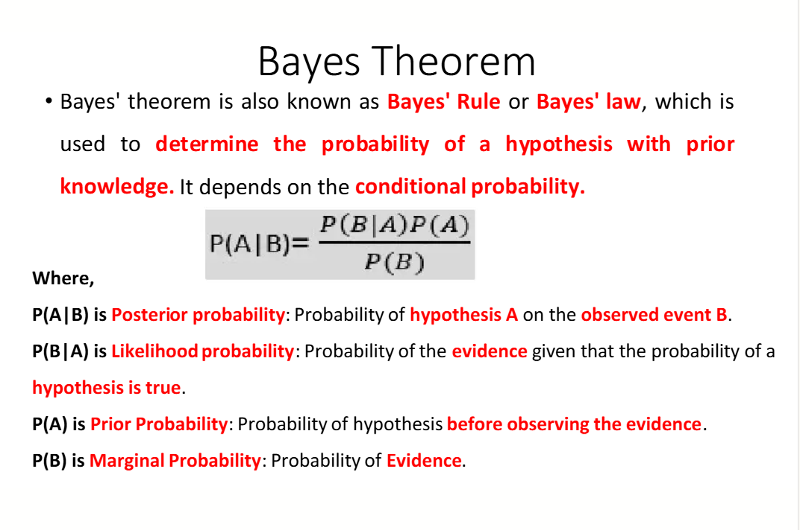

Slide 7
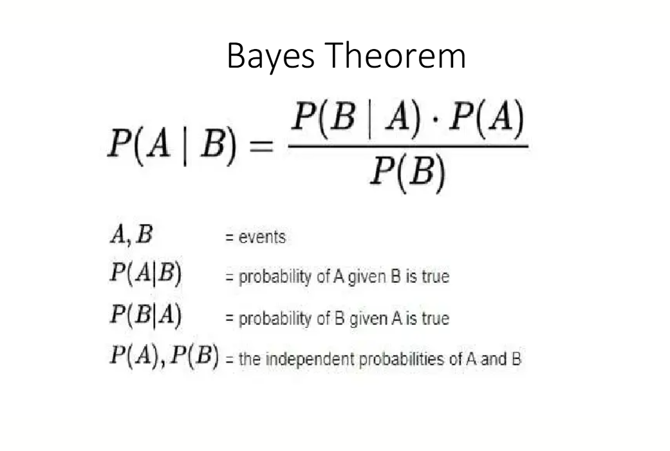

Slide 8
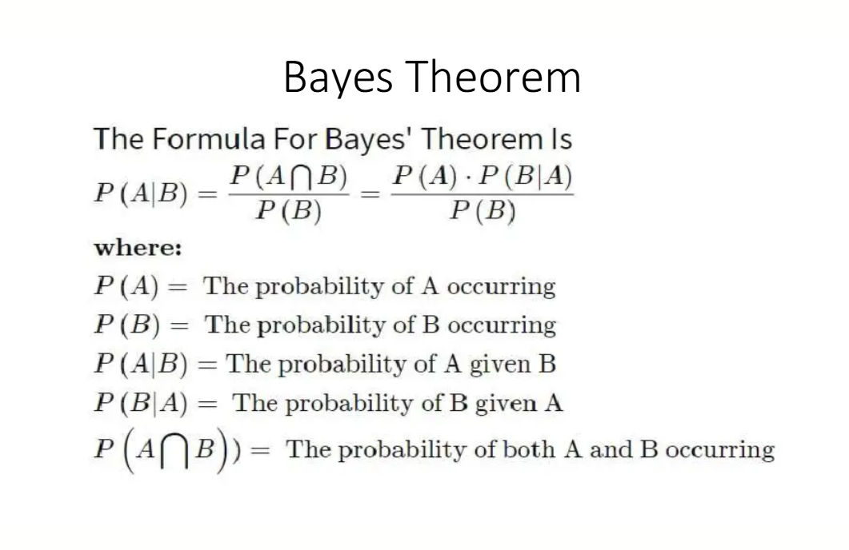

Slide 9
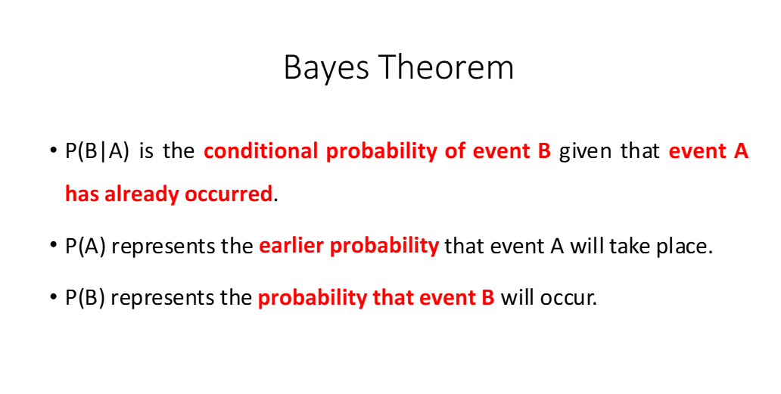

Slide 10
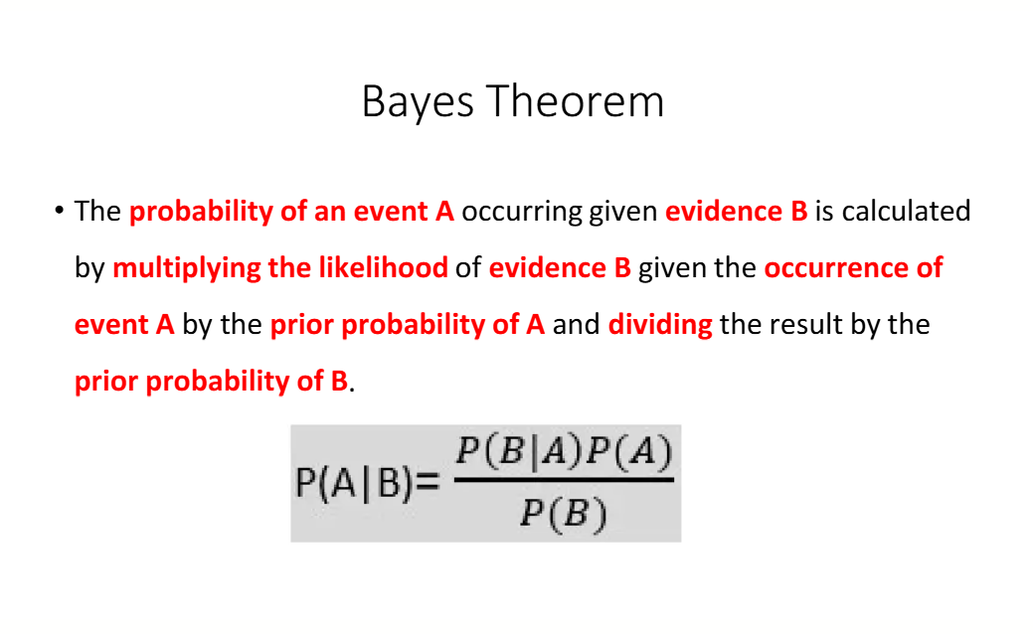

Slide 11
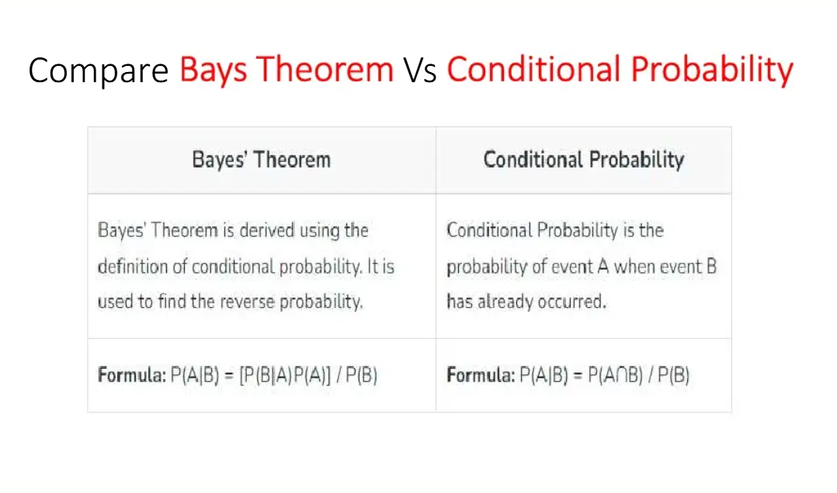

Slide 12
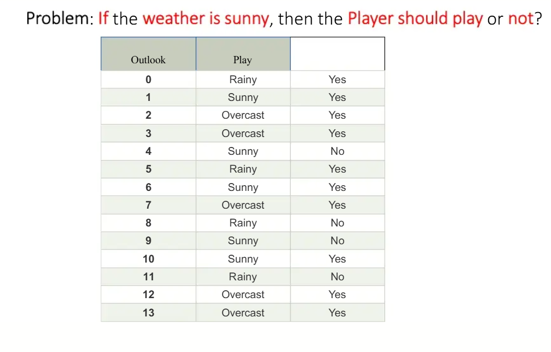

Slide 13
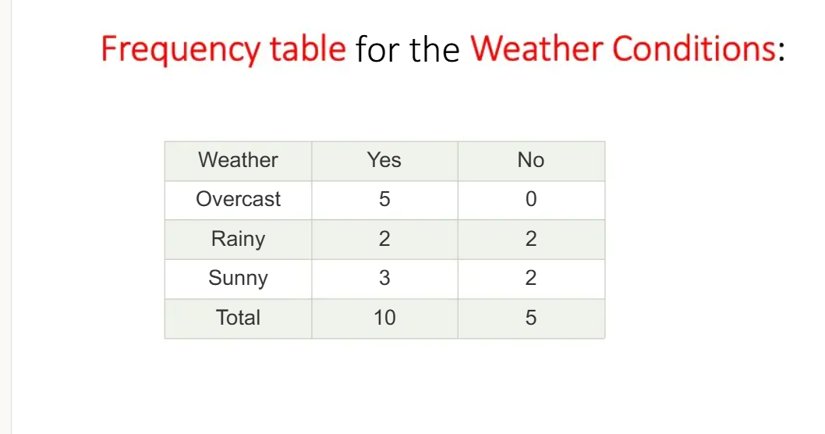

Slide 14
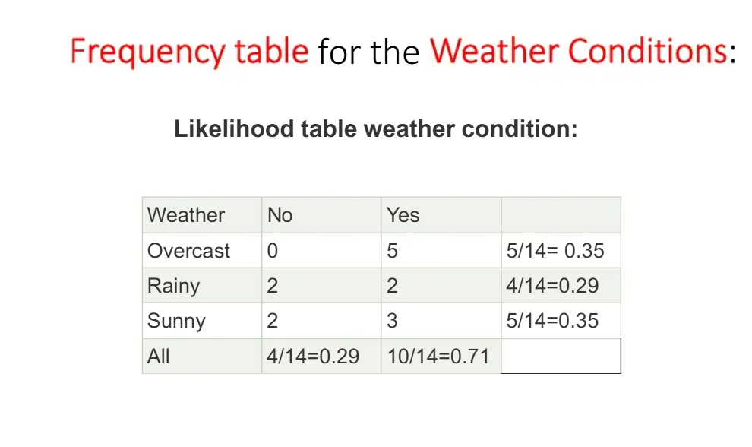

Slide 15
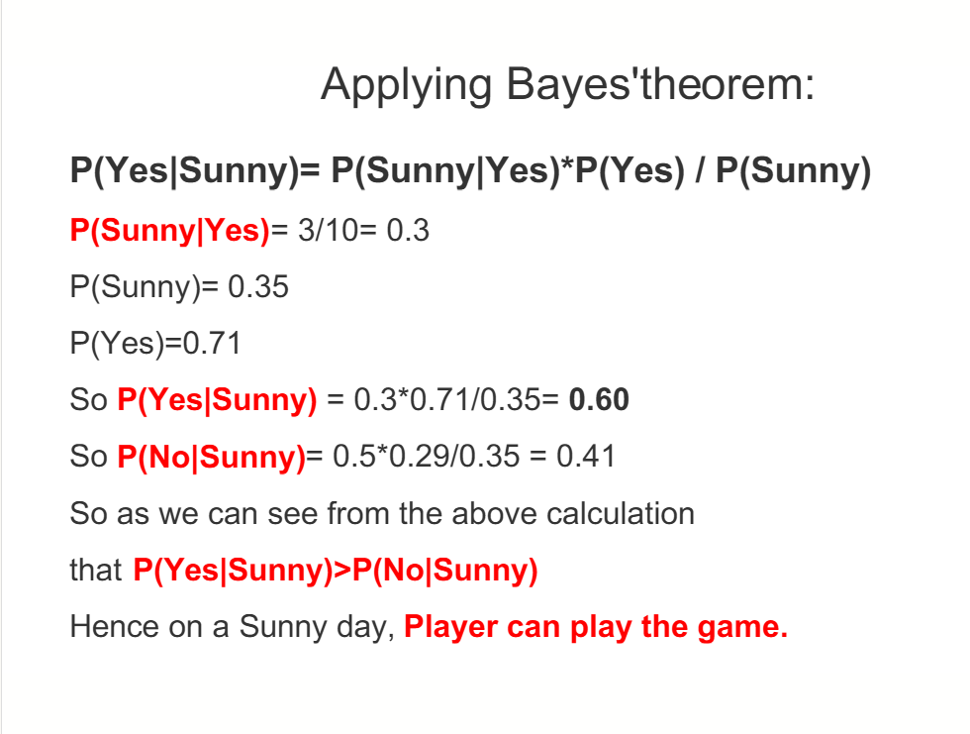

Slide 16
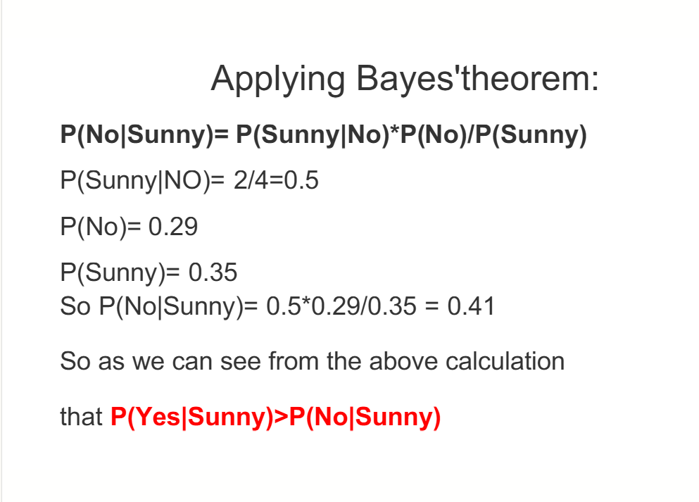

Slide 17
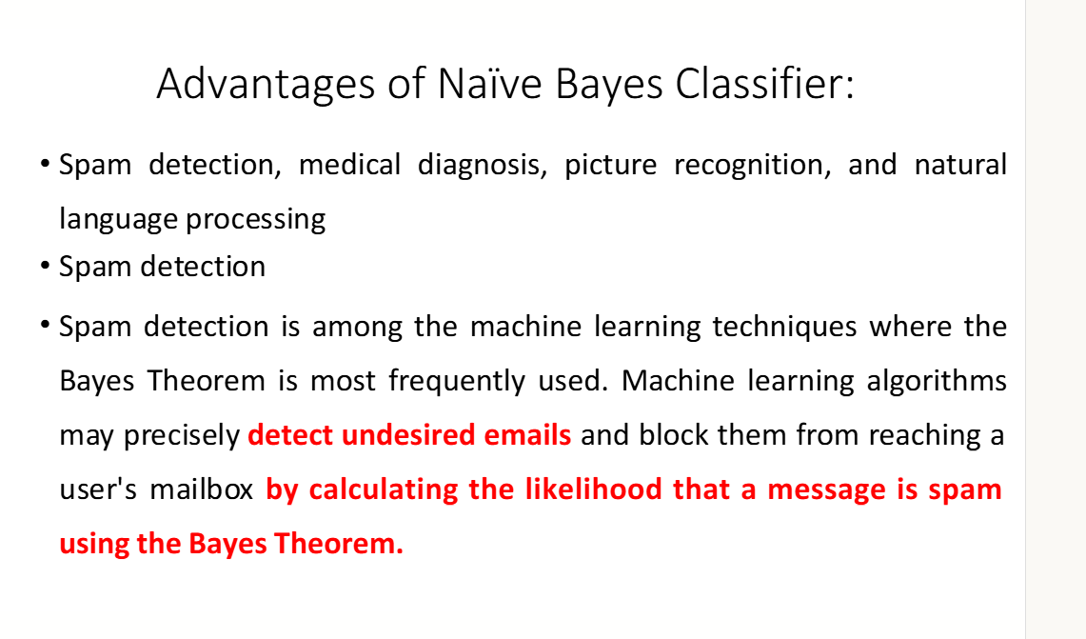

Slide 18
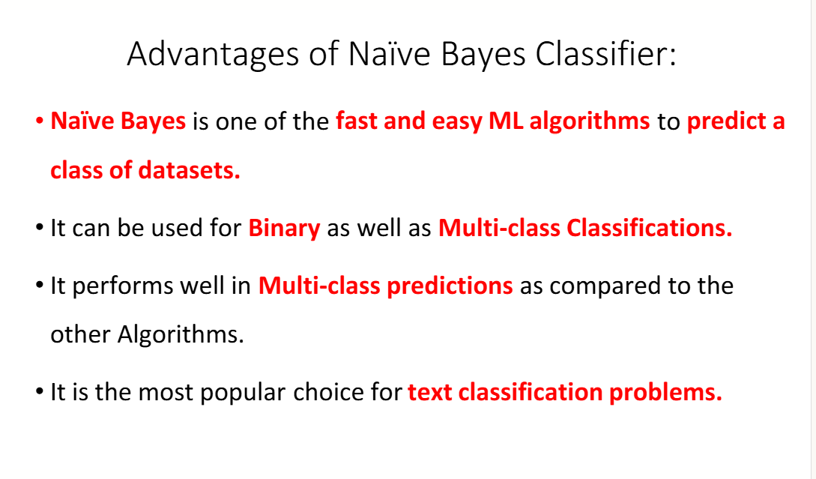

Slide 19
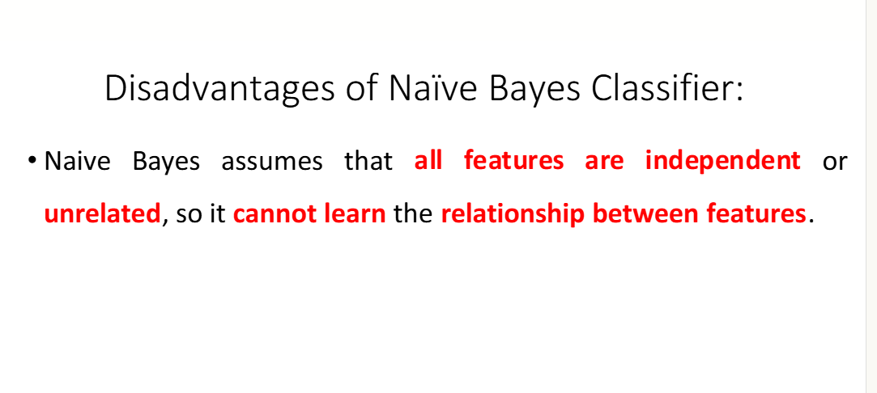

Slide 20
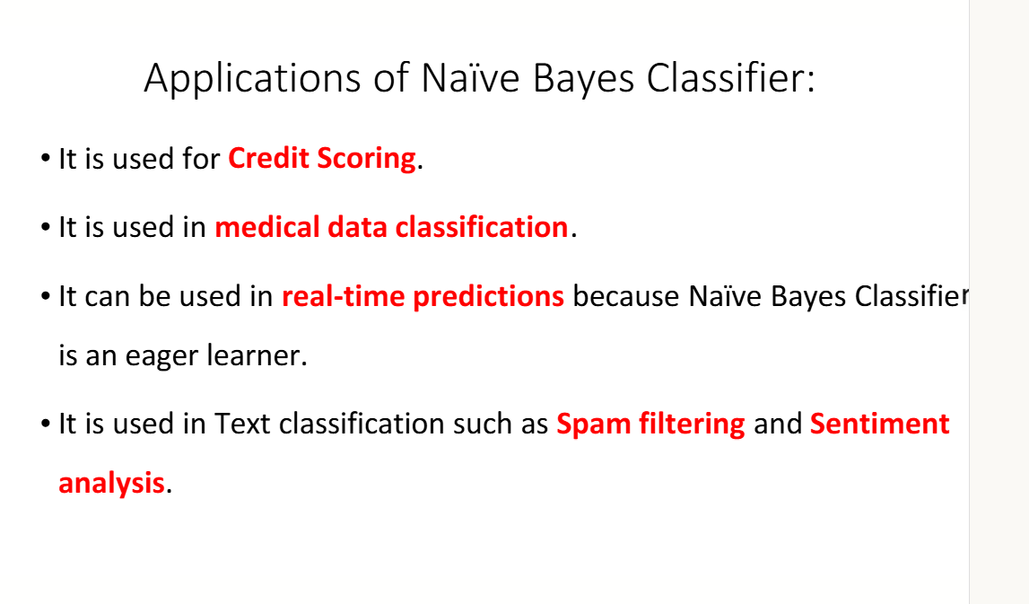

Slide 21
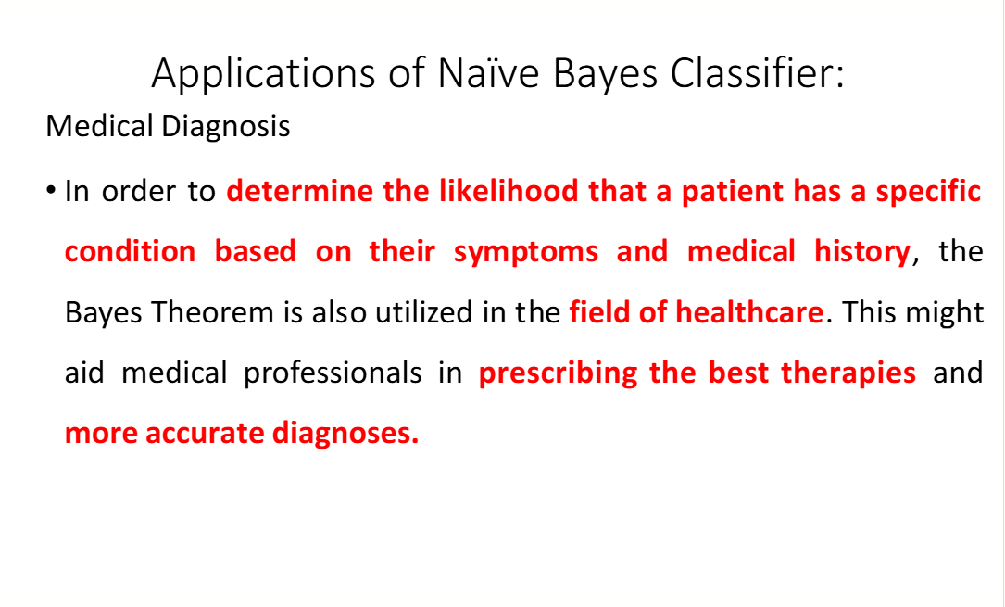

Slide 22
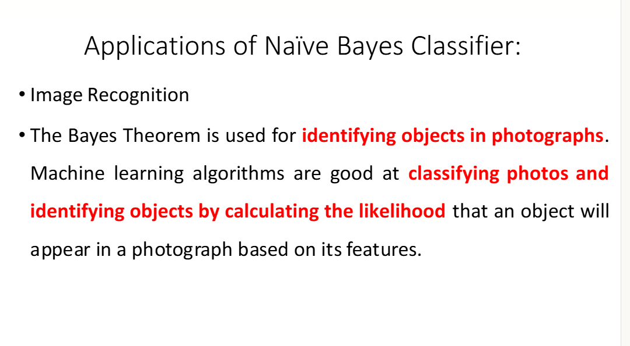

Slide 23
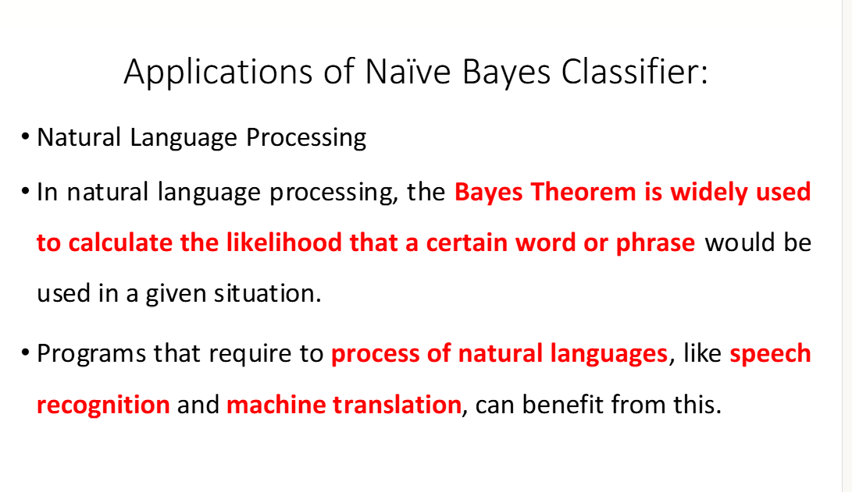

Slide 24
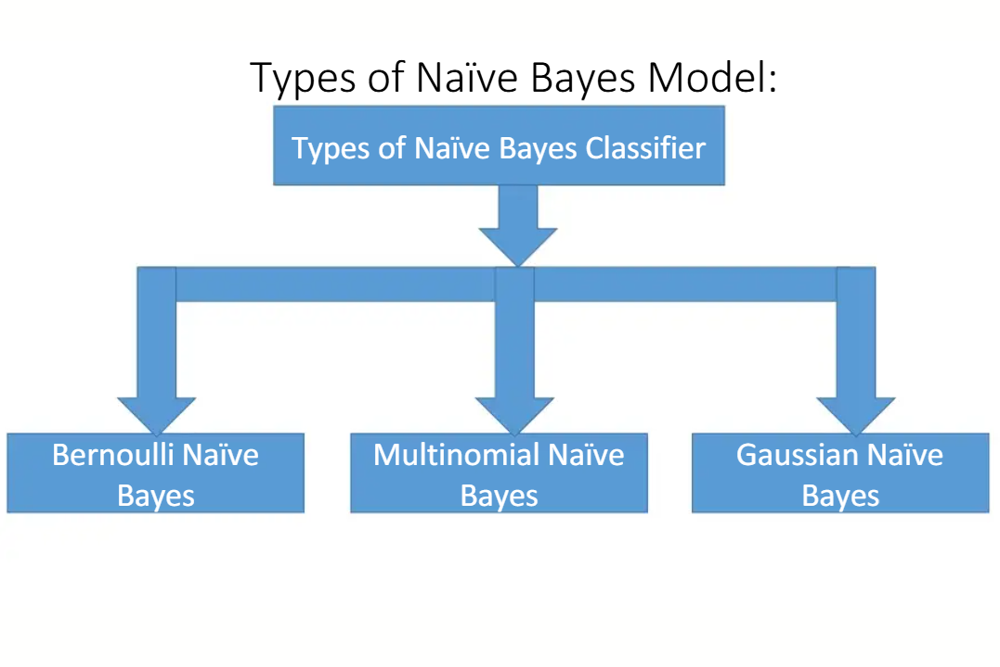

Slide 25
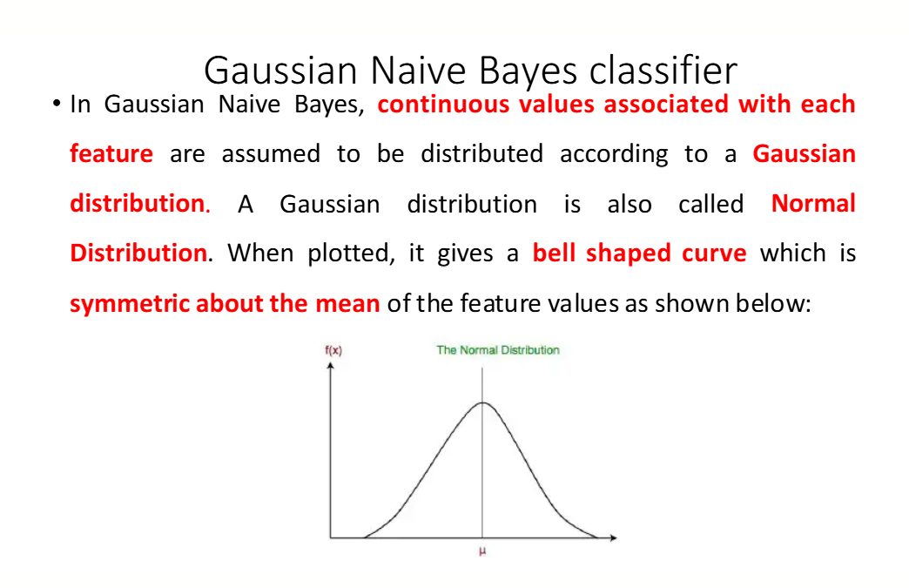

Slide 26
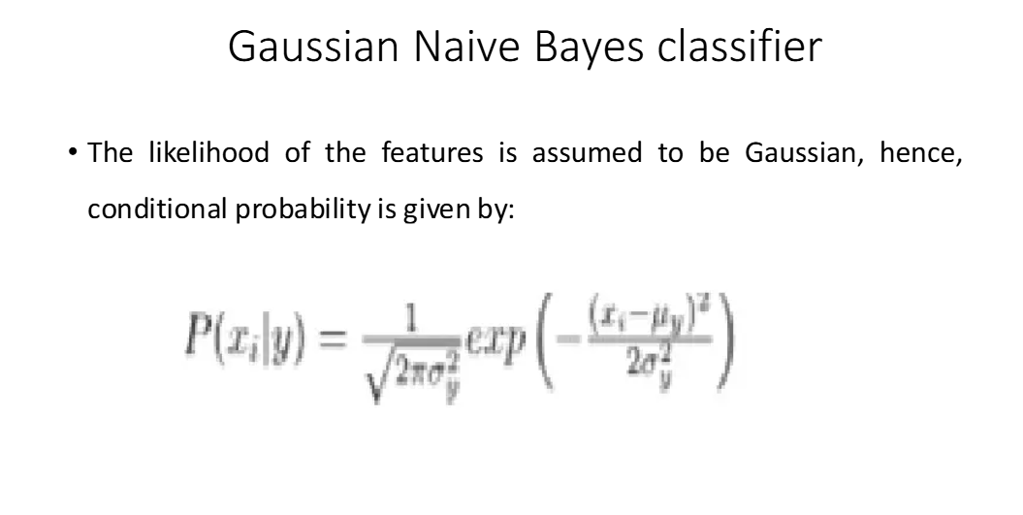

Slide 27
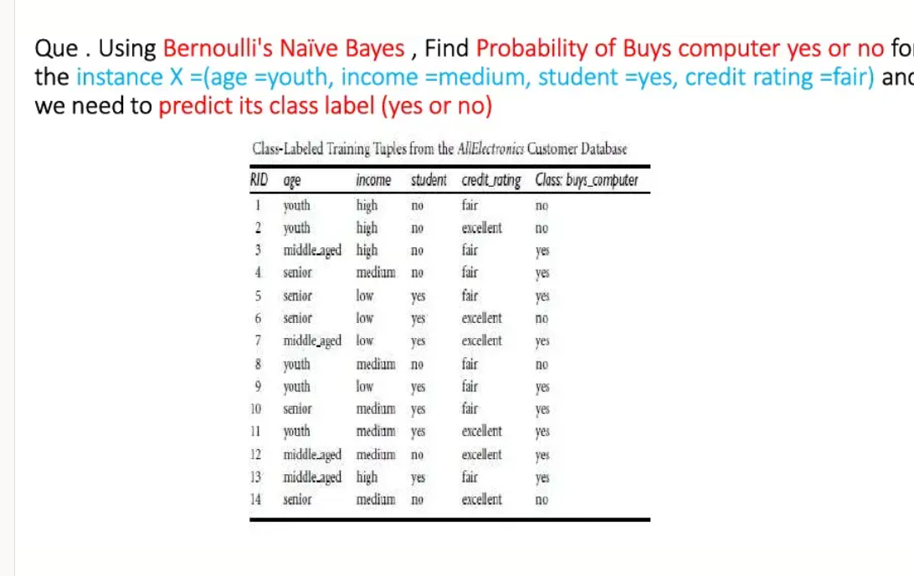

Slide 28
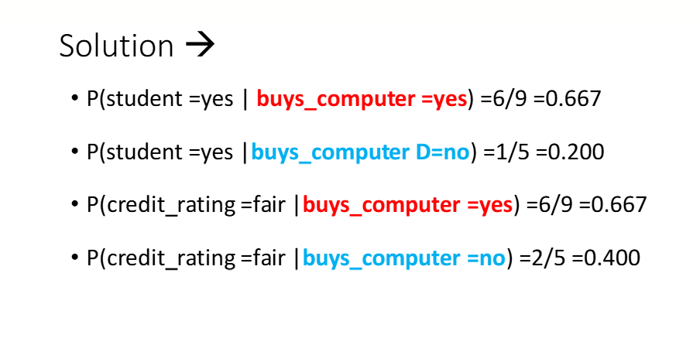

Slide 29
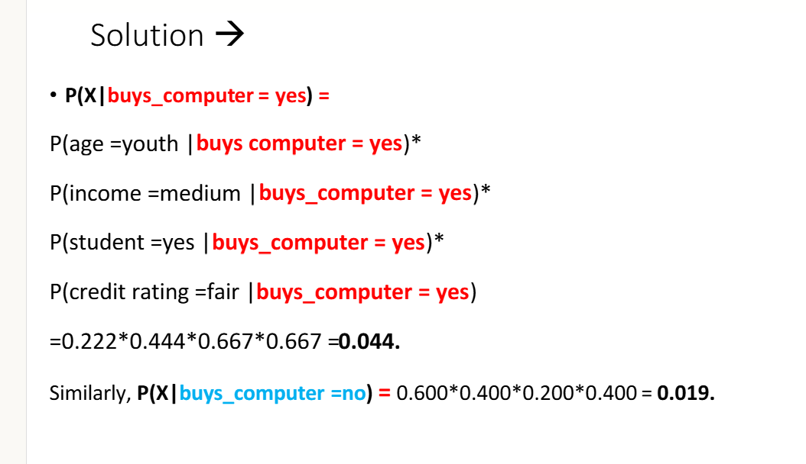

Slide 30
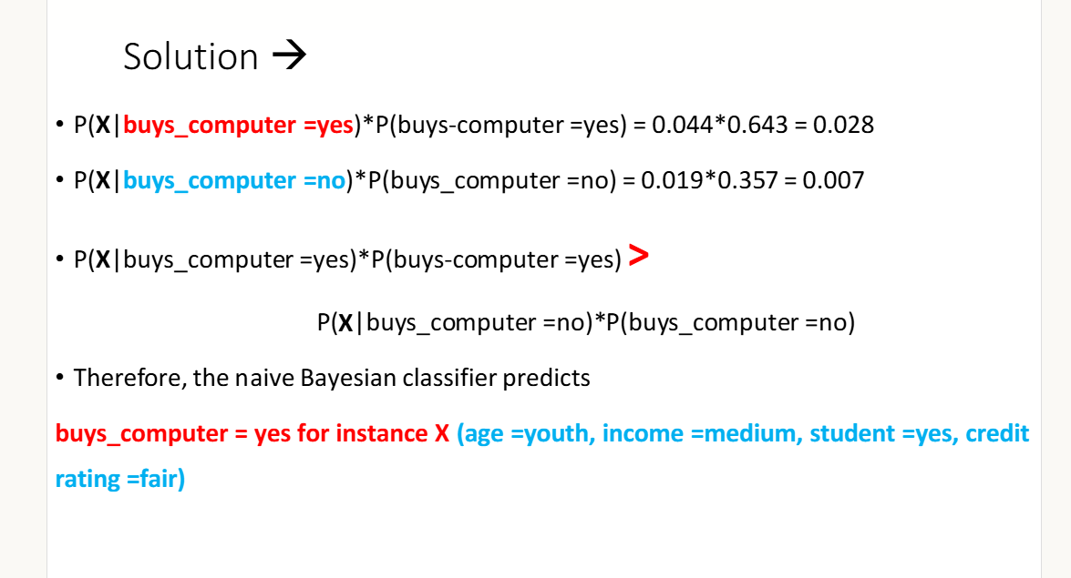

Slide 31
Gaussian Processes
A potent machine learning approach that may be used for both regression and classification problems is Gaussian process classification or GPC.
It is predicated on the notion of using a probabilistic model that depicts a distribution across functions, known as a Gaussian process.
Using this distribution, one may forecast a function's output given a collection of input data.
GPC may be used in the classification context to forecast a new data point's class label based on its attributes.
This is accomplished by modelling the likelihood of each class label for the data point using the Gaussian process. Next, it is predicted that the class label with the greatest probability is the actual class label.

Slide 32
CONTD..
Mean function: The anticipated value of the GP at any given input is represented by the mean function.
Covariance function: This function calculates how similar two inputs are to one another. It establishes the degree to which the GP at one input is dependent upon the GP at another.
Hyperparameters: The covariance function's shape is controlled by these parameters. Usually, a method known as marginal likelihood maximization is used to adjust them.
Marginal likelihood: A GP model's fit to a particular set of data is measured by the marginal likelihood. It is used to determine the optimal hyperparameters and assess the performance of various models.

Slide 33
Concepts of Gaussian Process Classification
Kernel functions:
A kernel function, often referred to as a covariance function, is an essential element that establishes the form of the GP's prior and posterior distributions in the setting of Gaussian processes (GPs).
It is vital for capturing the underlying correlations between input characteristics and goal values since it basically assesses how similar two data points are to each other.

Slide 34
Concepts of Gaussian Process Classification
Posterior Distribution: Our updated belief about the underlying function following data observation is represented by the posterior distribution in the Gaussian Process (GP). With the combination of the likelihood of observed data and the prior, which represents initial beliefs, a probability distribution over functions is produced. By offering a more accurate estimate of the true underlying function based on the evidence at hand, the posterior captures the process of reducing uncertainty. Through the incorporation of observed data into the modeling process, it facilitates well-informed decision making.

Slide 35
CONTD..
Prior Distribution: The prior distribution in Gaussian Process (GP) describes our presumptions about the underlying function before any data are observed.
It defines the potential functions that might be used to characterize the underlying process, acting as a versatile and expressive model.
Prior to taking into account actual data, our expectations and presumptions were reflected in the prior selection.
Because of its rich prior, the GP is an effective tool for modeling complex and uncertain systems in statistics and machine learning. It can capture a wide range of function behaviors.

Slide 36
Characteristics of Gaussian Processes:
Non-Parametric Nature: GPs can adjust to the complexity of the data because they do not rely on a set number of model parameters
Probabilistic Predictions: Predictions from GPs can be quantified because they deliver predictions as probability distributions.
Interpolation and Smoothing: GPs are useful for noisy or irregularly sampled data because they are good at smoothing noisy data and interpolating between data points.
Marginalization of Hyperparameters: By eliminating the requirement for explicit hyperparameter tweaking, they marginalize over hyperparameters, making the model simpler.

Slide 37
calibration and confidence.
Calibration and confidence refer to a model's ability to accurately represent the true likelihood of its predictions being correct. A well-calibrated model's confidence scores align with its actual performance, meaning a 70% confidence score implies a 70% accuracy rate over many predictions. This is crucial in high-stakes applications, such as medical diagnosis or self-driving cars, because it allows users to trust the model's output and identify potentially problematic predictions that should be reviewed or discarded, ultimately improving safety and reliability.
What is Calibration?
Matching Probability to Reality: Calibration ensures that the probability a model assigns to a prediction accurately reflects the real-world chance of that prediction being correct.

Slide 38
CONTD…
Trust in Confidence: For a model to be calibrated, its confidence scores should have a real-world meaning based on actual data, not just training data. Example: If a neural network predicts an image is a cat with 80% confidence, a well-calibrated model would be correct about 80% of the time for similar predictions.
Why is Calibration Important?
Safety and Reliability: In critical systems like autonomous vehicles or healthcare, accurate confidence scores are vital for avoiding severe errors.
Identifying Weak Predictions: Calibration allows for the detection and handling of low-quality predictions by associating them with low confidence levels

Slide 39
CONTD..
User Trust: Trusted predictions require well-calibrated confidence scores, which build user trust in the model's output.
How Does It Work in Practice?
Monitoring Uncertainty: A drop in confidence from a well-calibrated model can act as a signal to trigger safety mechanisms or prompt human review, such as in a self-driving car recognizing a stop sign.
Data-Driven Evaluation: Evaluating calibration involves assessing how much confidence scores can be trusted in relation to the model's actual accuracy on real-world data. Beyond Training Data: This process moves beyond just the training or validation data to ensure the model's confidence is reliable in practical, deployed scenarios.

